Slide 1
Brew And Blends!
Prototypes and walkthrough
By Thomas King, Charlie Cheung, Dlanyer Ocampo

Slide 2
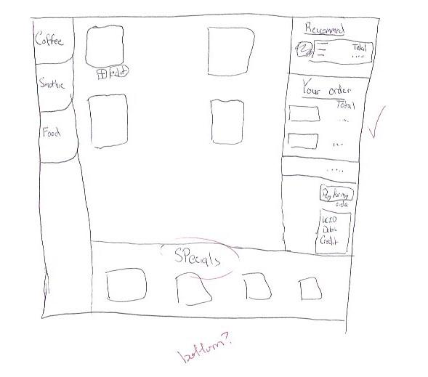
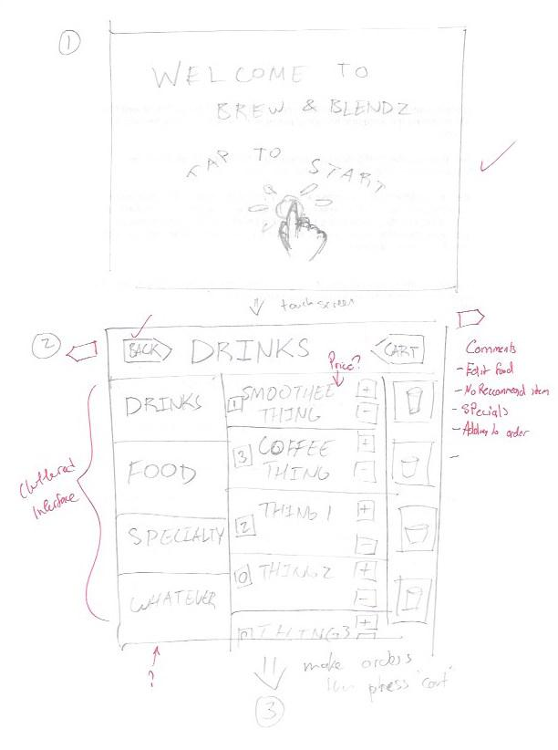
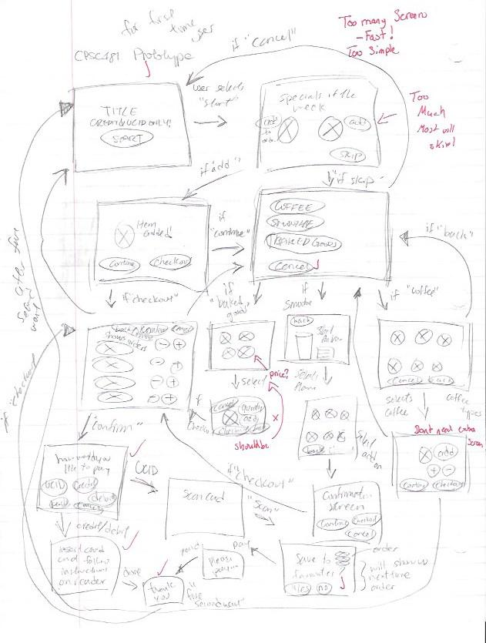
Initial Prototypes
We came up with our initial prototypes very roughly to just test out the waters on what it our prototypes would look like.

Slide 3
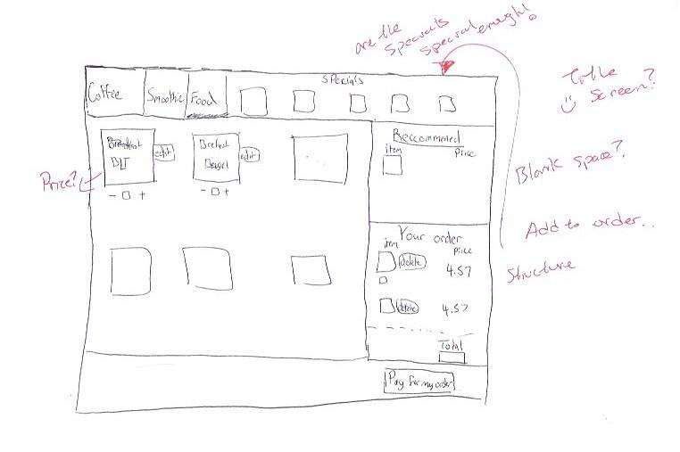

Slide 4
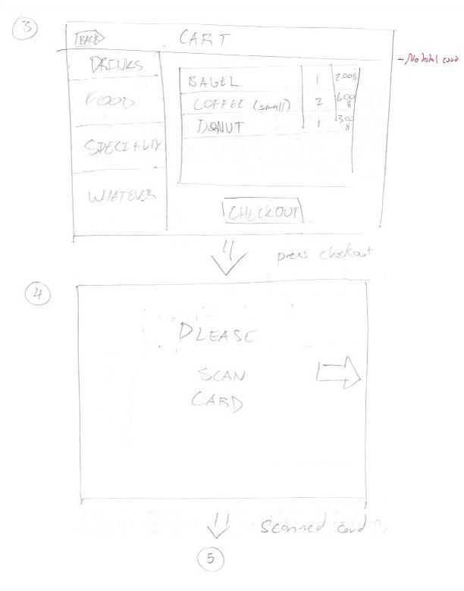

Slide 5
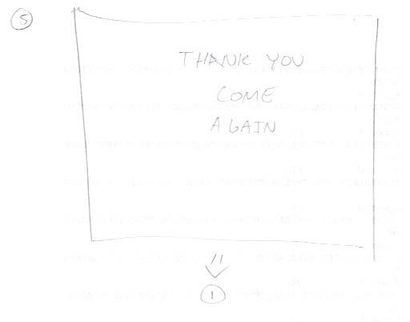

Slide 6
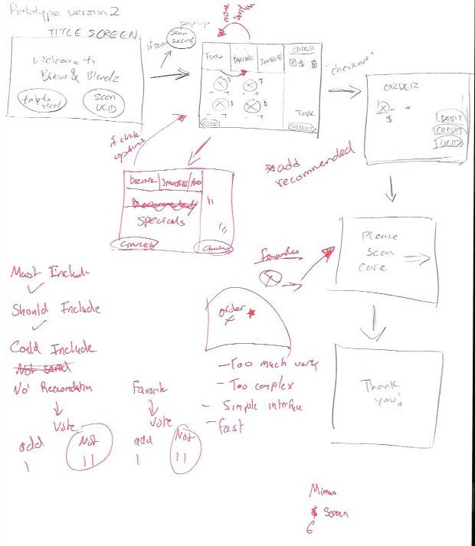
2nd generation prototypes
After reviewing each other's initial prototypes we evaluated what we really needed in our prototype as a group.
This included the start screen, checkout screen, and additional UI elements.

Slide 7
Final initial prototypes
After getting critique we added extra UI elements and polished the user interface itself adding other details such as incrementation/decrementation of items, price listings, specials/suggestions, etc.

Slide 8
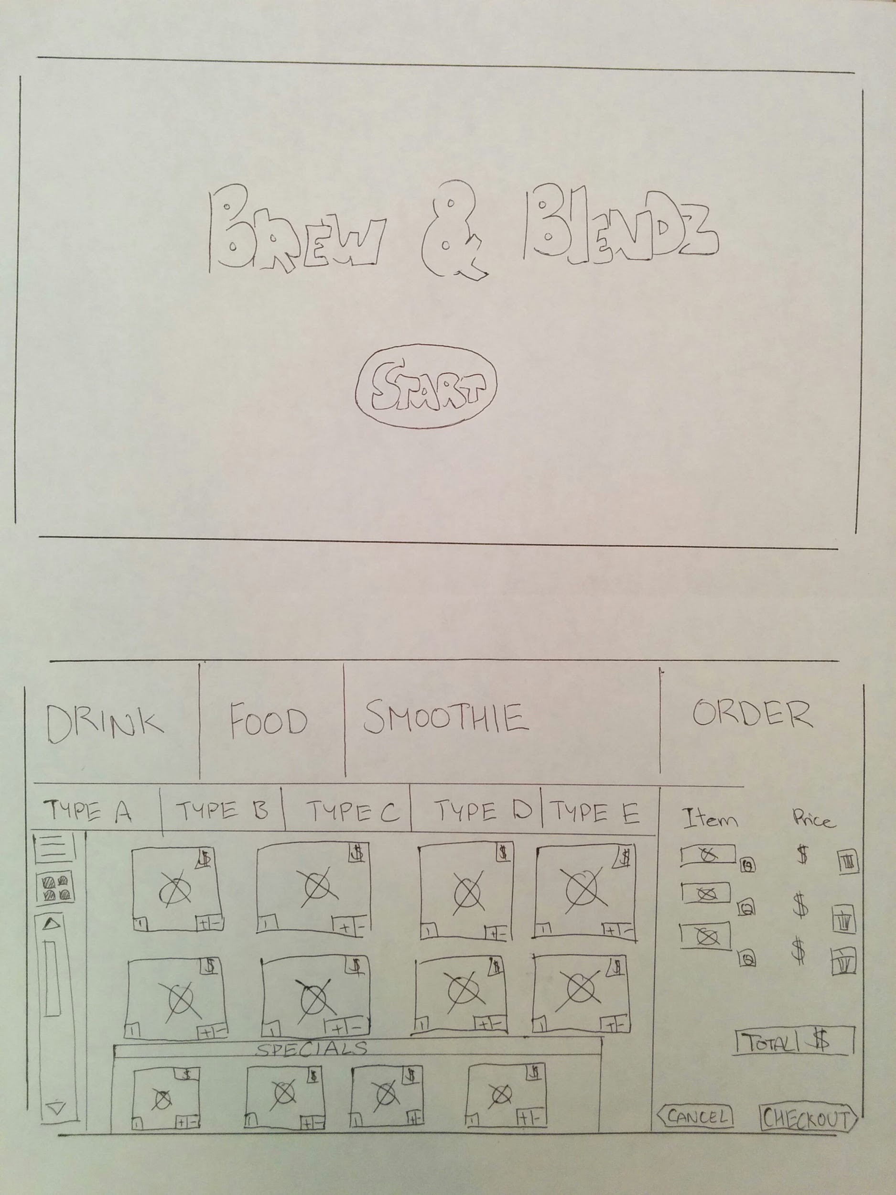
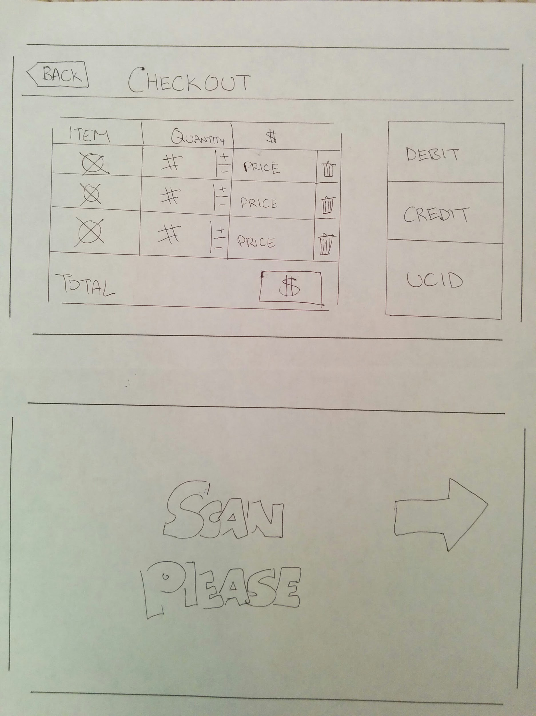

Slide 9
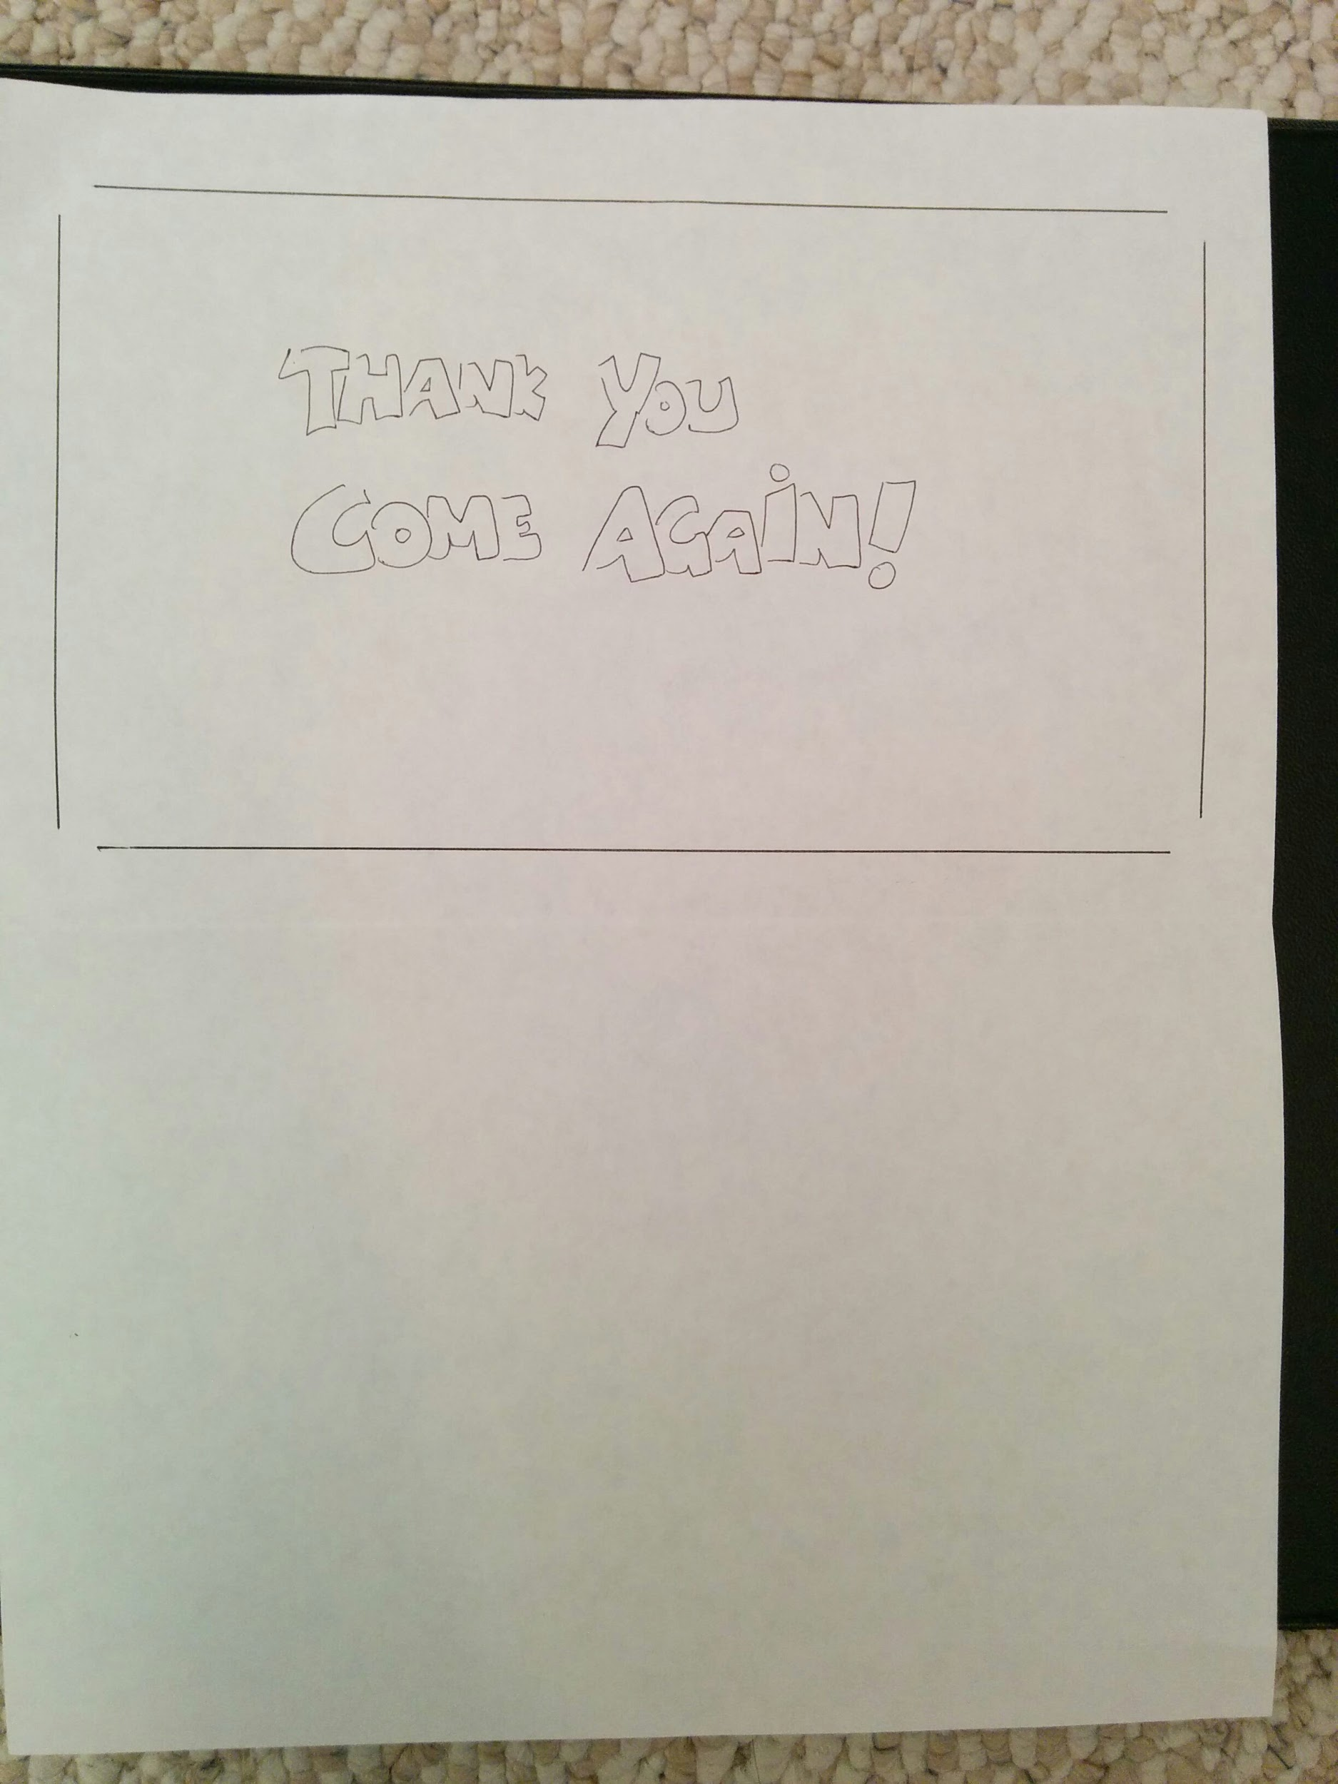

Slide 10
ProtoType Main system functionalities
Main functionalities
Ordering an item
Navigation through menus
Mode of payment (however no cash)
Switching views (grid, list)
Item modifications (quantity, delete)
Checkout/review order

Slide 11
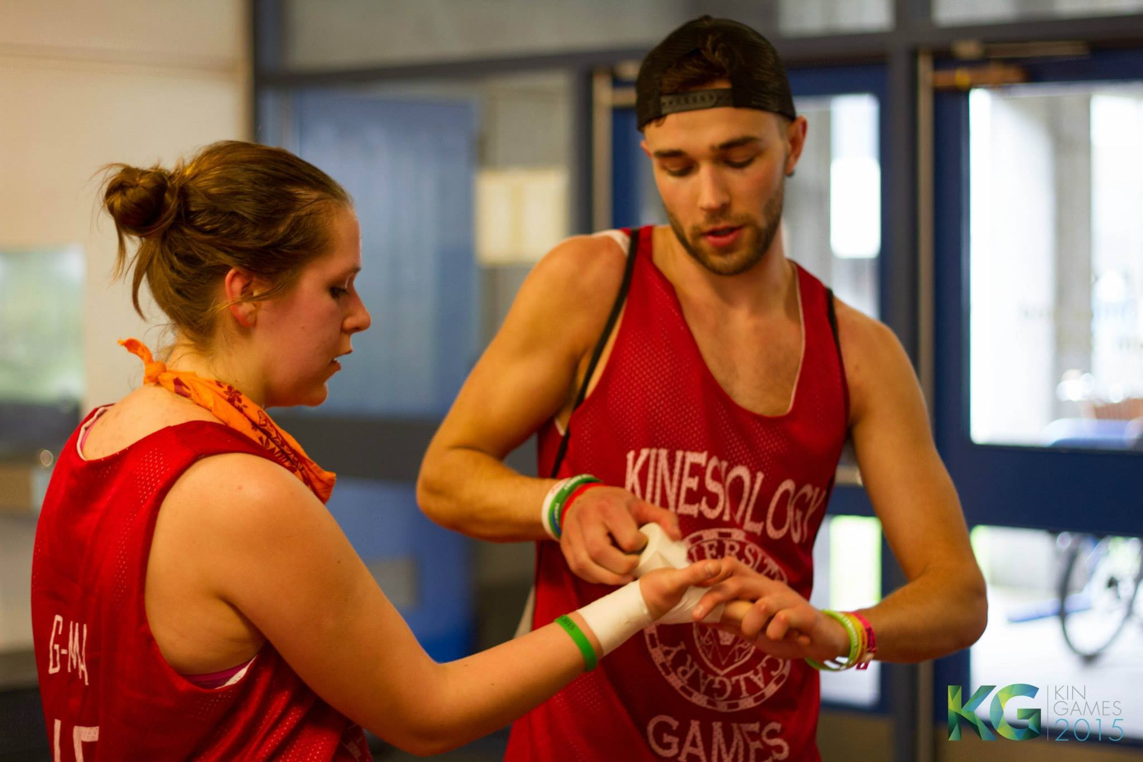
Task walkthrough
Remember Xander?
<- wow so sexy!!! <3
To Remember
Xander is common user at B&B, usually gets smoothie and food and is in between classes.

Slide 12
Ordering an Item from Brew & Blendz
Task step | Motivated? Knowledgeable? Believable? | Comments/Solutions
a. Xander arrives in front of Brew & Blendz | Ok. | He is in a rush and hungry.
b. Xander enters the interactive line up | Ok. | Xander is still able to read the boards Brew & Blendz has displayed so he already has a good idea of what he wants to order
c. Xander looks at the interface | Is Xander motivated to use the interface? Is he knowledgeable to even use it? | As a first time user he may be confused. Possible solution: Xander has touch interface experience.

Slide 13
Ordering an Item from Brew & Blendz (cont.)
Task step | Motivated? Knowledgeable? Believable? | Comments/Solutions
d. Xander taps the screen | Does he even want to click the screen? Does he know how to? | He wants to order something so he touches the screen. Possible solution: The system tells him to touch the screen.
e. Xander selects “Food Section” | Does he know how to navigate to his order? Is he motivated to use the interface (is it enticing, fun)? | Xander is able to locate the Food Section on the screen. Xander is able to select it so that images of Brew & Blendz’ food appears on the screen afterwards.
f. Xander searches for Bagel | Motivated to do so. Knowledge may be lacking. | Possible solution: Xander has knowledge of scroll interfaces. Xander is able to scroll down the screen until he finds the Bagel he wants.

Slide 14
Ordering an Item from Brew & Blendz (cont..)
Task step | Motivated? Knowledgeable? Believable? | Comments/Solutions
g. Xander presses a button to add to order | Motivated to do so. Expected to be knowledgeable. | Xander is able to find the Bagel that he was searching for. He taps to select the item and it appears under the Order tag on the screen. Xander recognizes that his bagel is now added to his order. Possible solution: Add an animation to tell the user that it has been ordered
h. Xander selects Smoothie Section | Similar to part e. Xander is motivated but he might not be knowledgeable. | Through previously interacting with the system when searching for the Bagel, Xander knows that he must select the Smoothie section before the Brew & Blendz’ smoothie menu appears on the screen.
i. Xander searches for his smoothie | Similar to part f. Xander is motivated to find his smoothie and we assume he is knowledgeable because he was able to find a Bagel | Through previous interaction with the system in the previous steps, Xander knows he is able to scroll down the menu to find the smoothie he wants.

Slide 15
Ordering an Item from Brew & Blendz (cont...)
Task step | Motivated? Knowledgeable? Believable? | Comments/Solutions
j. Xander presses a button to add to order | Motivated to do so in order to add the item to his order. We assume he is knowledgeable because it is the same interaction as for his previous order. | Xander selects the smoothie he wishes to add to his order. The smoothie will then appear under his order on the screen so Xander knows it has been added to his order
k. Xander checks his order | Ok. Does he know where to check? | Xander checks his order over by confirming that both the items he has ordered appears under the order tab. Xander also checks that the total is the sum of the items he’s ordered before proceeding.
l. Xander goes to checkout | Can he locate the checkout button? Is he motivated to go to the checkout? | Xander is in a hurry to confirm his order. It may take him longer to find the checkout button if he is first time. Possible solution: He knows the checkout button leads to paying and can find it.

Slide 16
Ordering an Item from Brew & Blendz (cont....)
Task step | Motivated? Knowledgeable? Believable? | Comments/Solutions
m. Xander reviews his checkout | Ok. Is Xander motivated to know if his order his correct? Is Xander knowledgeable of what appears on the screen? | Xander reviews his order for a final time before proceeding. He notes the items he ordered, the quantity of the items, the individual prices, and the cumulative total.
n. Xander chooses UCID | Ok. We assume Xander is knowledgeable about his preferred payment method. Is he knowledgeable to click to UCID? | Possible Solution: Add a title saying “Pay for order by” Xander selects the UCID option on the screen so that he can pay through his meal plan.
o. Xander scans his UCID | Does he know how to scan it? We assume he is motivated to scan his UCID so that he may get his order | The screen will direct Xander to the scanner on the side of the machine so that he can scan his UCID. Possible solution: he sees the scanner and has experience with scanners

Slide 17
Ordering an Item from Brew & Blendz (cont.....)
Task step | Motivated? Knowledgeable? Believable? | Comments/Solutions
p. Xander confirms his payment | How does he know the order went through? Is he motivated to see that his order went through? | Xander has successfully scanned his UCID and paid for his order. He waits for either the system or the scanner to confirm that his UCID scan was successful. Possible solution: He sees the thank you message and knows it is been ordered. Clear screen back to home, to tell the user to continue.
q. Xander waits for order | Ok. | Xander has confirmed that his order has gone through. He now waits for his order to be completed.
r. Xander receives his order | Ok. | Xander receives his order from a Brew & Blendz employee and confirms that it is the same items that he ordered on the system.

Slide 18

Ordering an Item from Brew & Blendz (cont......)
Task step | Motivated? Knowledgeable? Believable? | Comments/Solutions
s. Xander leaves for class | Ok. | His order has been confirmed, paid for, and received. Xander can now leave for class, food and smoothie in hand.

Slide 19
Potential problems/Future improvements?
Main Problems
Initial users may not know how to use the system
Potential navigation issues
Potential Future improvements
Make the UI more accommodating to new users (simplicity)
Consideration for combos, suggestions, etc. (maybe)
Consideration for better navigation design

Slide 20

Thank you for your time

